Slide 1

Course Walkthrough
DevOps Live Classes

Slide 2
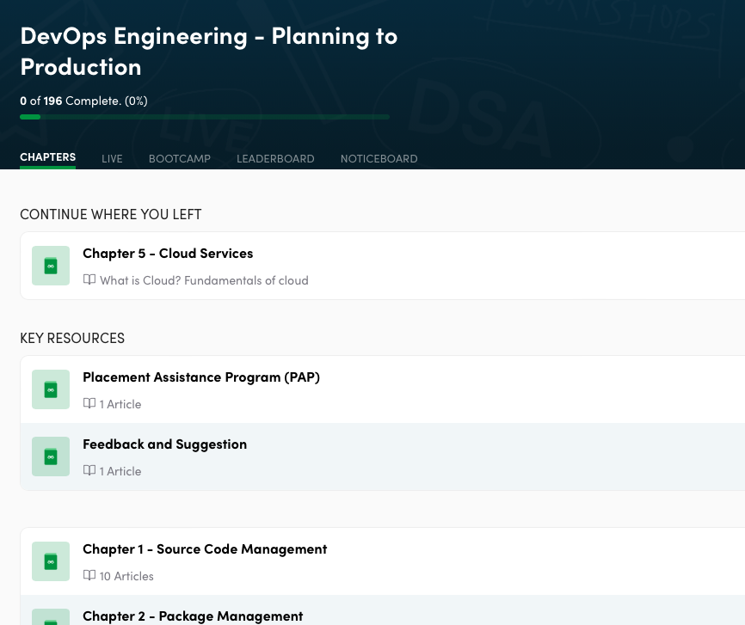
Course Structure
Chapters
Live
Contest
Leaderboard
Noticeboard

Slide 3
Chapters tab to access all the pre-recorded lectures & notes:
DevOps Notes
Source Code Management
Package Management
CICD
Container Management
Cloud services
IaS
Monitoring
Linux Notes
Git-Github Videos & MCQs

Slide 4
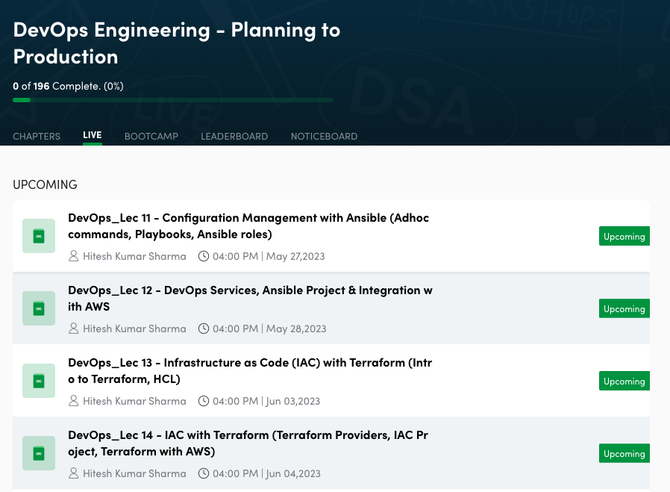
Live Classes - Upcoming

Slide 5
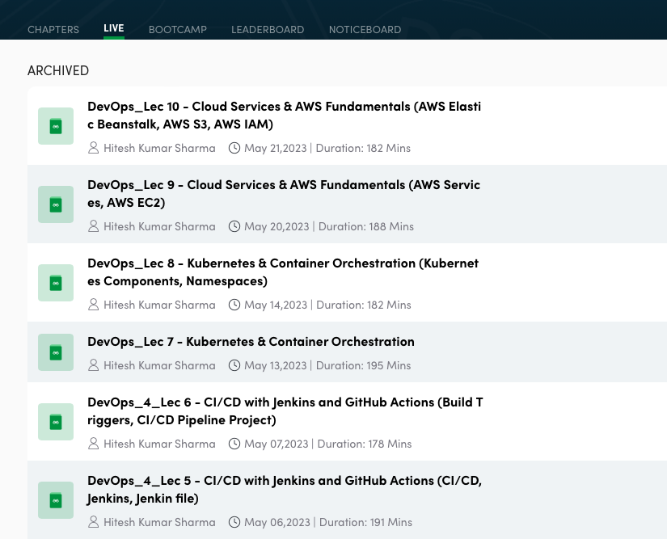
Live Classes - Archived (i.e Live Classes Recording)
Note: It will be available after 24-48 hrs of live session

Slide 6
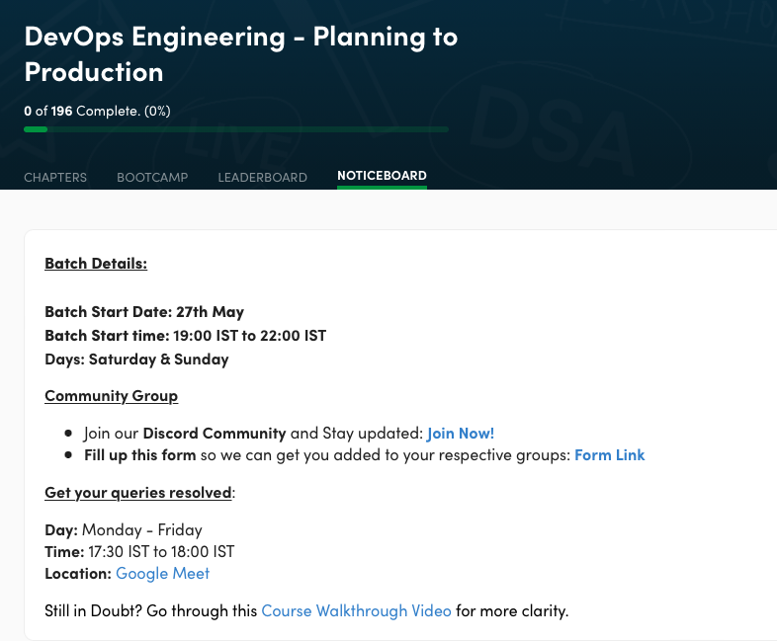
Noticeboard
It will consist of all important notifications: 1) Placement Assistance Test details 2) Discord Link 3) Google Meet link wherein you can 1-1 report your queries related to course. Monday - Friday (17:00 IST - 18:00 IST)

Slide 7
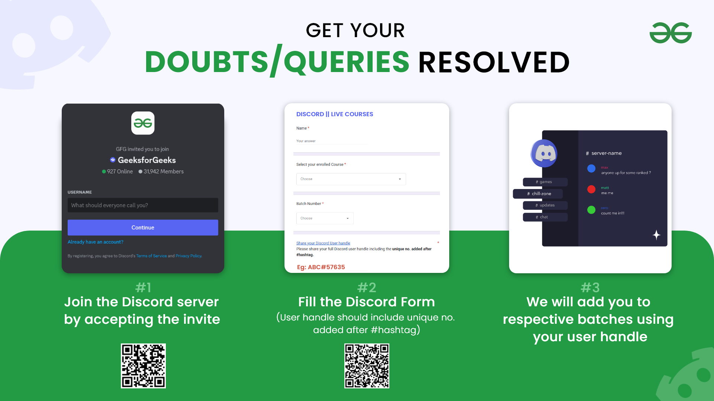
Steps to Join Discord:

Slide 8
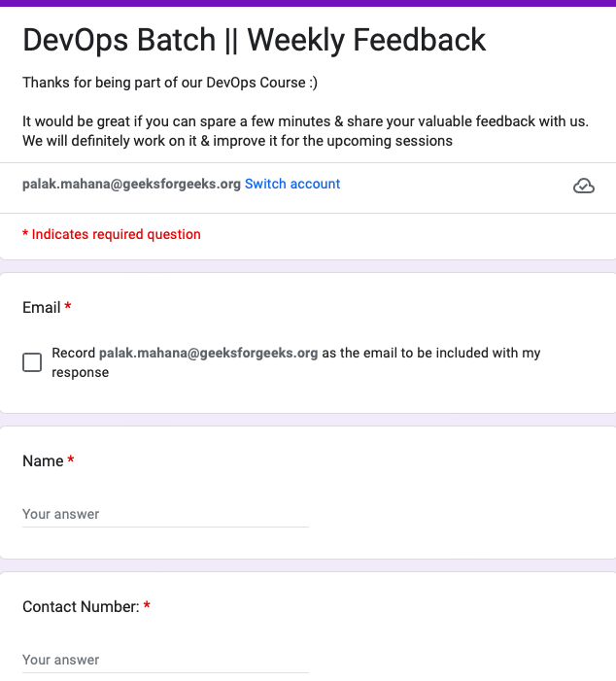
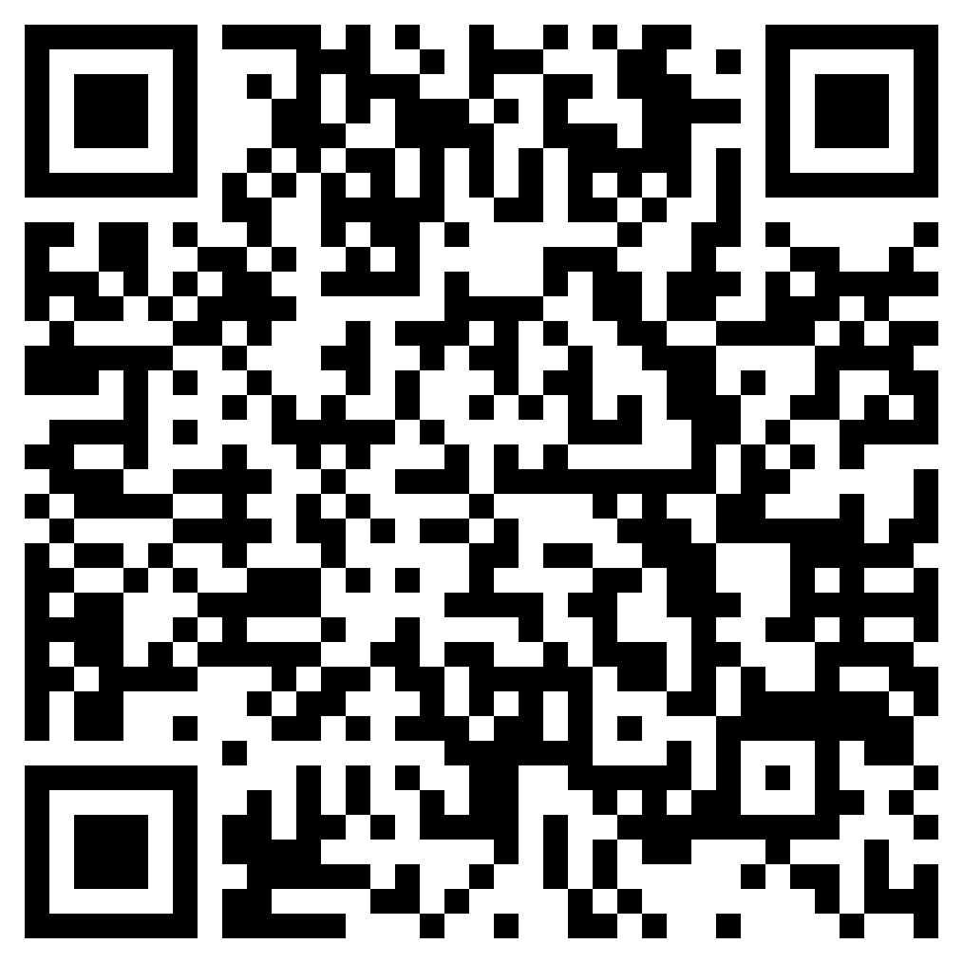
Provide Feedback after every class
Scan to share your feedback

Slide 9
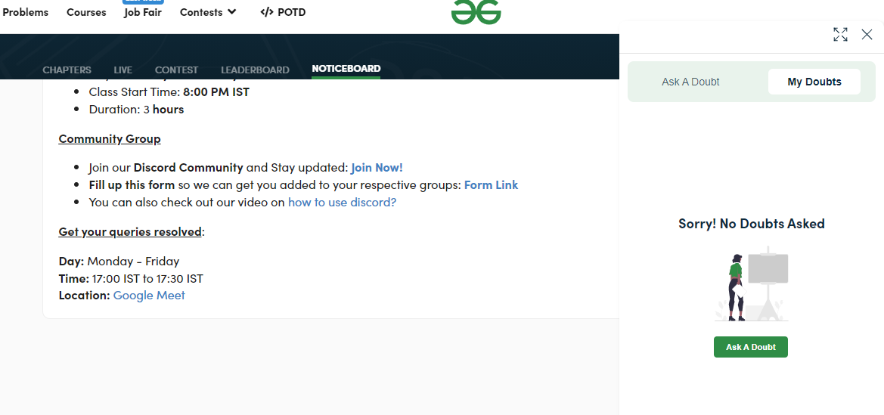
How to ask doubt?
#1 Click on ‘Ask a Doubt’

Slide 10
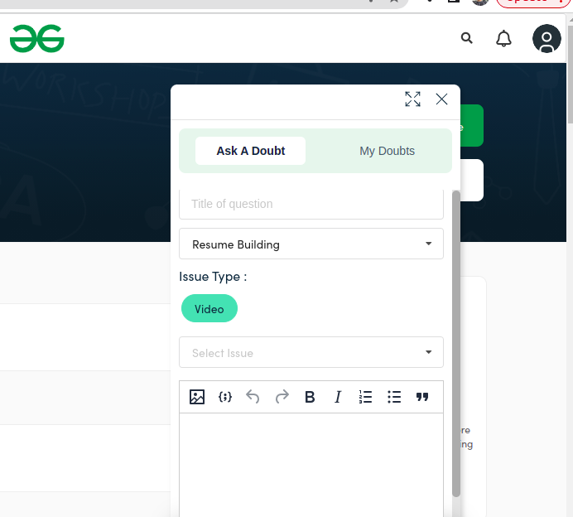
How to ask doubt?
#2 Ask a Doubt
Issue type- Video/ Problem/Quiz
TA will give your resolution
#3 For doubts related to live classes
Post your doubts in discord channel

Slide 11
How Placement Assistance works?
We hold Placement Assessment Test (PAT)
You will have only 2 PAT attempts in this course.
PAT Syllabus: DevOps MCQs, Aptitude Reasoning Questions PROCEDURE:
Candidates who pass the PAT will have their profiles shared with our partner companies, and will have the opportunity to be interviewed for relevant positions
Onboarding: This includes Resume Screening and a Prep Talk to ensure you're well-prepared for the job market
JD (Job Description) sharing with the candidates who have the relevant skill set
CV forwarding to organizations that are hiring
Regular feedback to candidates to keep them informed of their progress
Scheduling your calls/interview at a time that is convenient for you
Selection/Rejection feedback is provided to candidates to keep them informed of the outcome
Note: Next PAT - Mid of June (tentatively)

Slide 12
Preparation for Live Classes | Week wise plan
Week 1: (Class 1 & 2)
Live Syllabus: DevOps Fundamentals (YAML, Linux), Git, GitHub, VCS, Networking
Recorded Content: Git-Github
Week 2: (Class 3 & 4)
Live Syllabus: Docker & Containerization (Docker file, Docker hub, Docker Images, Containers, Docker Command, Docker Volume, Project)

Slide 13
Preparation for Live Classes | Week wise plan
Week 3: (Class 5 & 6)
Live Syllabus: CI/CD with Jenkins and GitHub Actions (CI/CD, Jenkins, Jenkin file, Build Triggers, CI/CD Pipeline Project)
Week 4: (Class 7 & 8)
Live Syllabus: Kubernetes & Container Orchestration, Kubernetes Components, Namespaces

Slide 14
Preparation for Live Classes | Week wise plan
Week 5: Classes 9 & 10
Live Syllabus: Cloud Services & AWS Fundamentals (AWS Services, AWS EC2, AWS Elastic Beanstalk, AWS S3, AWS IAM)
Week 6: Classes 11 & 12
Live Syllabus: Configuration Management with Ansible (Adhoc commands, Playbooks, Ansible roles), DevOps Services, Ansible Project & Integration with AWS.

Slide 15
Preparation for Live Classes | Week wise plan
Week 7: Classes 13 & 14
Live Syllabus: Infrastructure as Code (IAC) with Terraform (Intro to Terraform, HCL, Terraform Providers, IAC Project, Terraform with AWS)
Week 8: Classes 15 & 16
Live Syllabus: Monitoring, Logging, and Project (Prometheus, Grafana), Creating Custom Dashboards, Major Project

